Slide 1
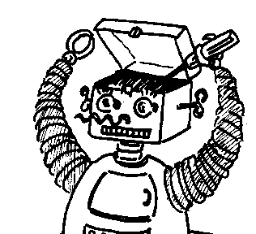

Maryland Metacognition Seminar
Folk Intuitions about Selves & Responsibility: First computational steps
Paul Bello
Office of Naval Research, Arlington, VA
27 July 2012, 12:00 PM
A. V. Williams Bldg., RM. 3258, College Park
Abstract:
In this talk, we computationally explore a case study of human intuitions about the self and responsibility. We hypothesize that a significant portion of the variance in reported intuitions for this case might be explained by appeal to an interplay between the human ability to mindread (i.e., to ascribe mental states to both self and other) and the way that knowledge is organized conceptually in the cognitive system. In the talk, we build on a pre-existing computational model of mindreading by adding constraints related to psychological distance, a well-established psychological theory of conceptual organization. Our initial results suggest that studies of folk concepts involved in moral intuitions lead us to an enriched understanding of cognitive architecture and a more systematic method for interpreting the data generated by studies of human folk concepts.

